Slide 1

AI-Based Freelance-Startup System Progress Presentation
Week 04

Slide 2

01 Project Positioning
02 Weekly Progress
03 Planning and Next Steps
Contents
CATALOGUE

Slide 3


01 Project Positioning

Slide 4
Current Phase
C
Phase 1: Intelligent Foundation
Focus: System Design and Core Architecture
Goal of Week 04: Advance further in the implementation
C
Phase Tasks:
AI Recommendation Tool (Candidate Match)
Data Coherence AI
AI Predictive Tool
Selection and Mission Update
Mission Deployment
Application Tracking System
Profile Engineering and Authentication

Slide 5
Weekly Objective
01
Complete the Objectives of Each Service
Ensure all microservices (Mission, Analytics, AI Orchestrator, etc.) fully implement their planned functionalities for Phase 1.
02
Improve the Objectives of Each Tool
Improve and test tools (Profile Analyzer, AI Recommendation modules) to meet functional requirements.
02
Integrate Frontend with Backend
Connect the frontend interface to the backend services for all features developed in this phase, enabling end-to-end functionality.

Slide 6
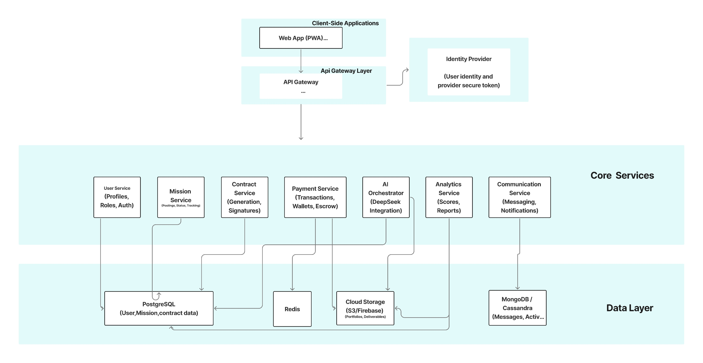
Project Architecture

Slide 7

02 Weekly Progress

Slide 8
Work Completed This Week
Mission Service
Objective
Developing the final Selection Function to officially assign a freelancer and update the mission status globally.
Developing the Publish Mission functionality, allowing startups to define requirements such as (Title, Description, Skills, Budget, and Duration).
Functionallities:
Implement Mission Publishing

Slide 9
Work Completed This Week
User Service
Objective
Creating and managing detailed Startup Profiles, including startup information and mission statistics to build professional credibility.
Creating and managing detailed Freelancer Profiles, including freelancer information and skills.
Functionallities:
Defining the Profile engernering logic
Defining the JWT Authentication logic

Slide 10
Work Completed This Week
Frontend:
Create well-structured service files with API configuration and DTOs to ensure a clear, efficient, and maintainable connection between the frontend and backend.
AI Orchestrator:
Define and begin implementing the AI orchestrator, Establishing the core architecture and beginning to integrate key features, including chat, prompt management, and tool integrations.
API Gateway:
Implement a JavaScript-based API Gateway for centralized request routing.

Slide 11

03 Planning and Next steps

Slide 12
Plan for the Next Week
Complete the Objectives of Each Service
01
Ensure all microservices (Mission, Analytics, AI Orchestrator, etc.) fully implement their planned functionalities for Phase 1.
Improve the Objectives of Each Tool
02
Improve and test tools (Profile Analyzer, AI Recommendation modules) to meet functional requirements.
Integrate Frontend with Backend
03
Connect the frontend interface to the backend services for all features developed in this phase, enabling end-to-end functionality.

Slide 13

Thank you

